Slide 1
Airline Delay & Cancellation Analysis (2015)
Micro-Project 4: Machine Learning 2 of 2 https://github.com/checkamani/micro-project-4
Rogomparade Zeba
November 23, 2025

Slide 2
Problem Statement
Flight delays and cancellations are a key operational challenge for airlines and airports.
This project explores the 2015 U.S. flight-delay data to identify patterns of departure and arrival delays across airlines and airports.

Slide 3
Hypothesis Formulation
H₀ (null): There is no significant difference in average departure delay across U.S. airlines and airports.
H₁ (alternative): Average departure delay differs significantly by airline and airport.

Slide 4
Acquire
Dataset: Flight Delays and Cancellations (2015), https://www.kaggle.com/datasets/usdot/flight-delays
Source: Kaggle - U.S. Department of Transportation – Bureau of Transportation Statistics
File Used: flights.csv
Size: ≈ 5,819,079 rows × 31 columns
Key Variables: fl_date, airline, origin_airport, destination_airport, depature_delay, arrival_delay, cancelled, distance, weather_delay, air_delay, security_delay, late_aircraft_delay

Slide 5
Prepare
Tasks performed with NumPy + Pandas:
Loaded the dataset and inspected structure (.info(), .shape()).
Filtered the dataset to retain only features directly related to arrival-delay modeling.
Constructed fl_date from YEAR, MONTH, DAY and parsed to datetime.
Dropped rows missing delay values.
Kept early (negative) departures; created nonnegative delay minutes via clipping for summaries (e.g., dep_delay_min = max(departure_delay, 0)).
Created a derived variable Delay_Status (>15 min = “Delayed”).
Removed duplicates.
Saved cleaned data as cleaned_flights.csv.

Slide 6
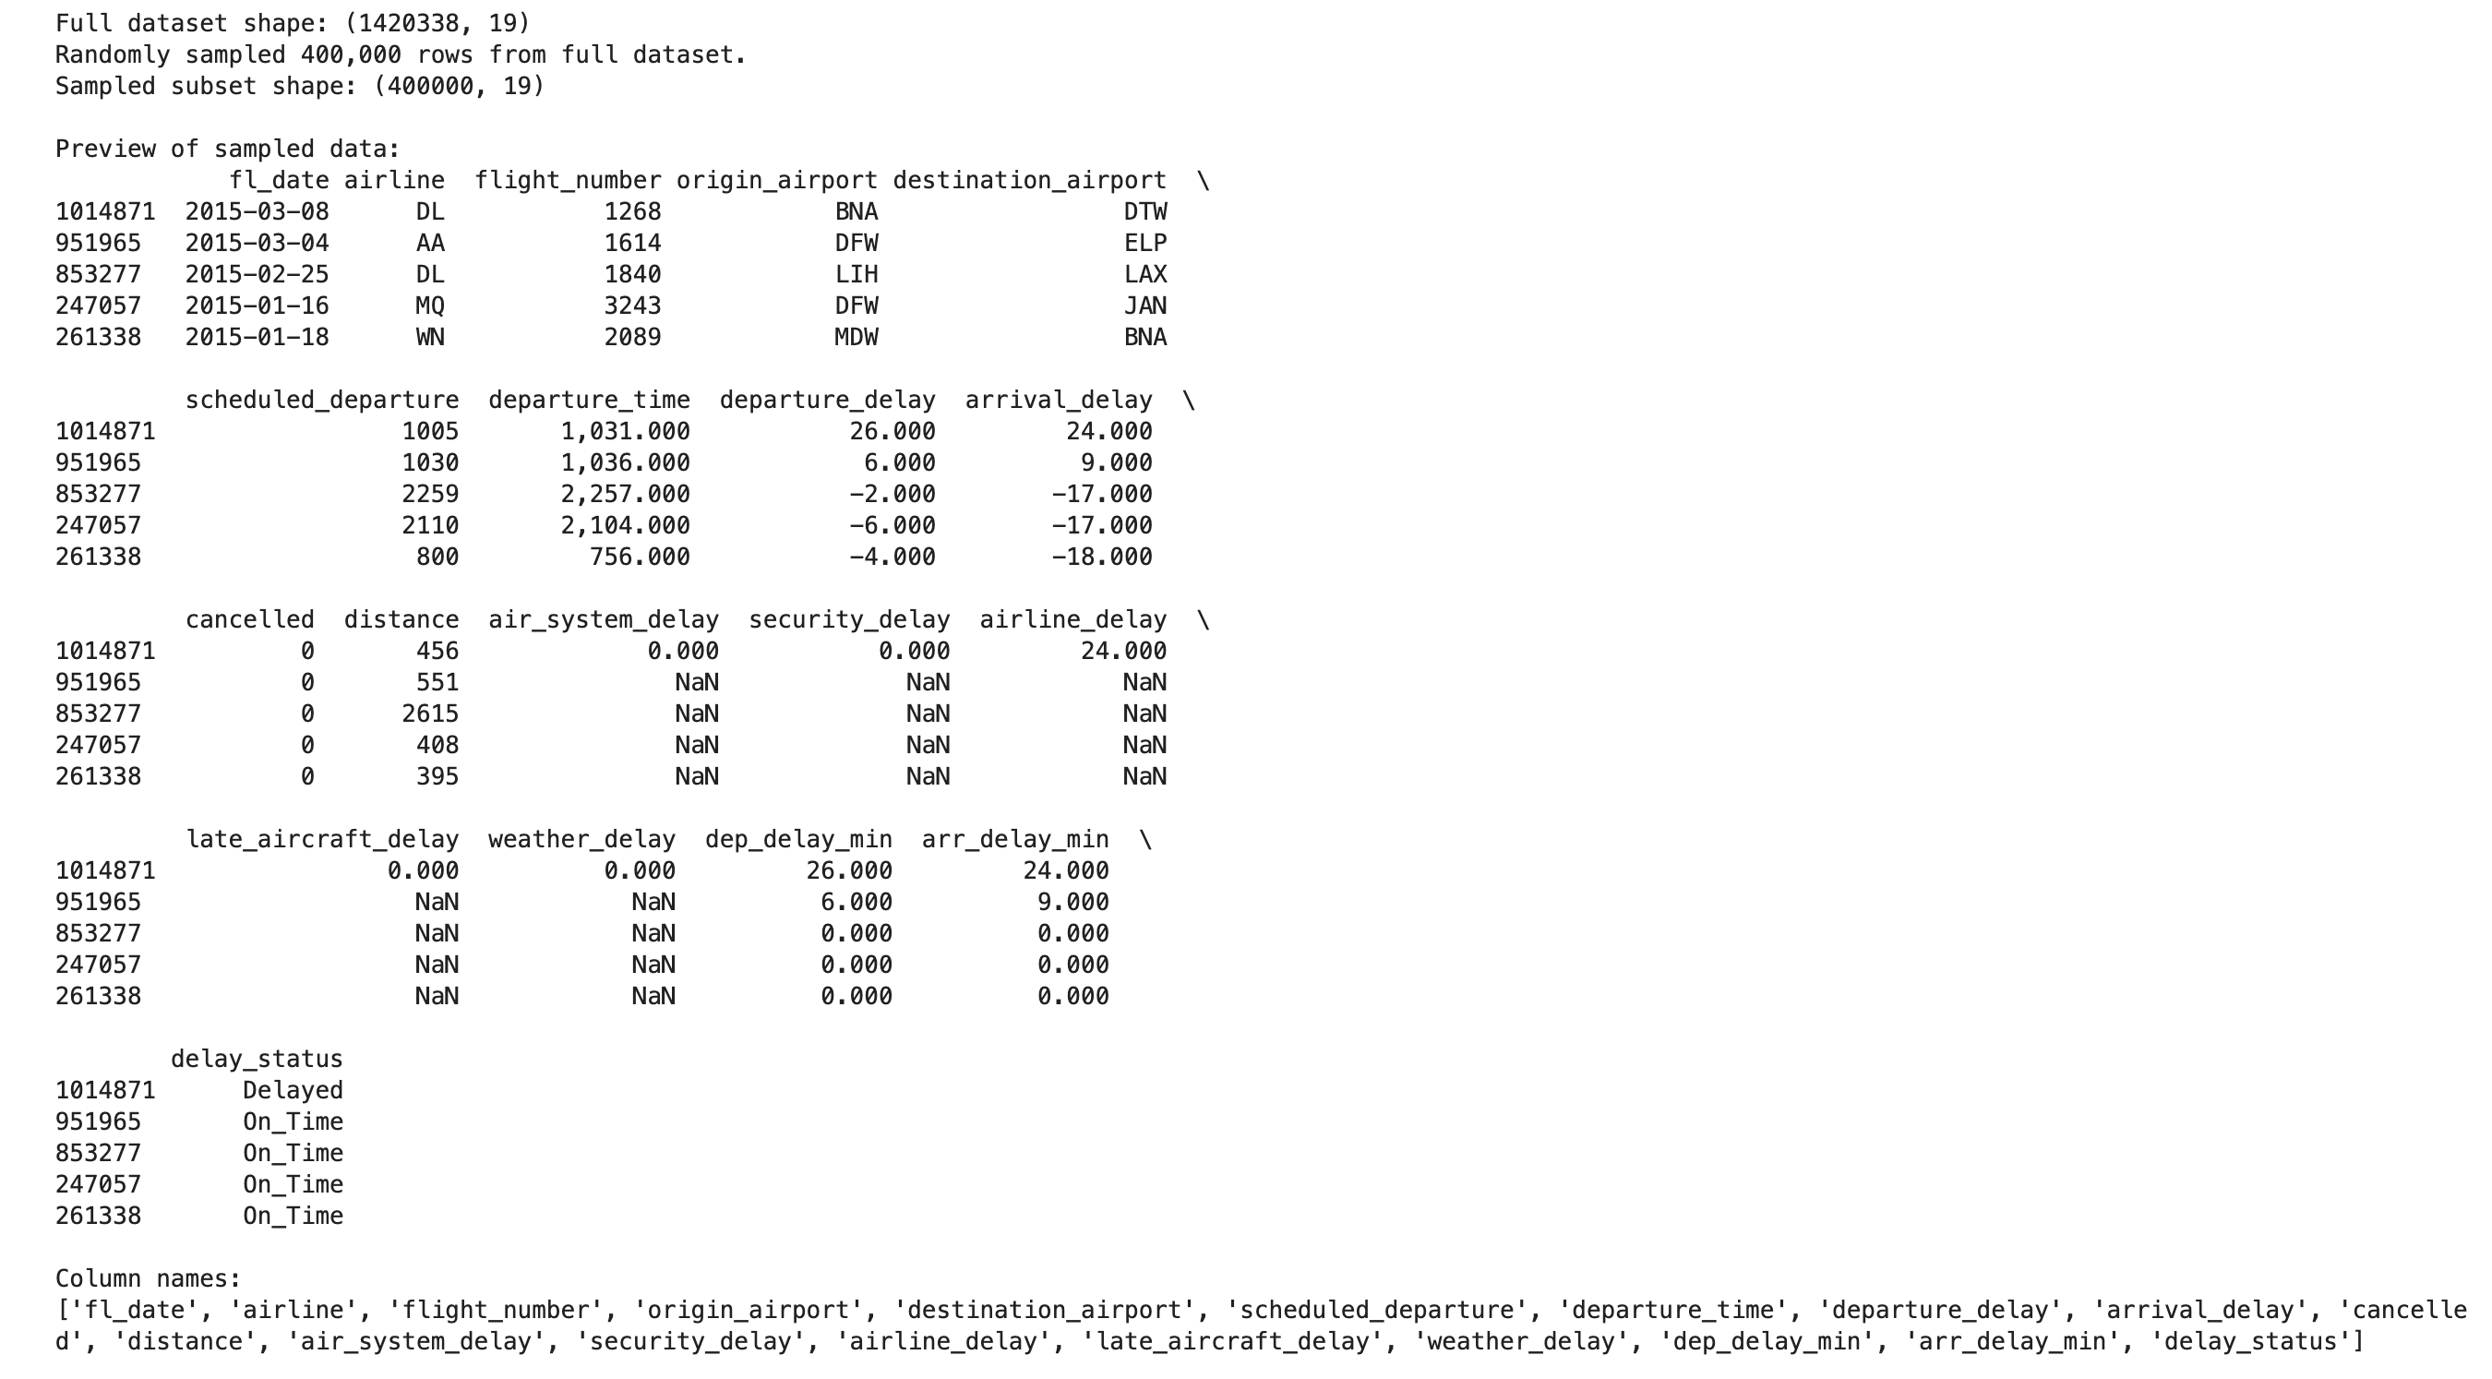
Prepare
Result: A clean, structured dataset ready for analysis.

Slide 7
Analyze data
Technique Selected:
Descriptive analytics and visualization using Python (Pandas, Seaborn, Matplotlib).
Approach:
- Summarized key delay statistics (mean, median, spread).
- Visualized delay distributions using histograms and KDE to assess skewness.
- Compared average delays across airlines and airports.
- Analyzed monthly patterns to identify seasonal peaks.
- Assessed the relationship between departure and arrival delays using correlation.
Key Insight:
Delays are right-skewed, peak during summer and holiday months, and show a strong departure–arrival correlation (r ≈ 0.8).

Slide 8
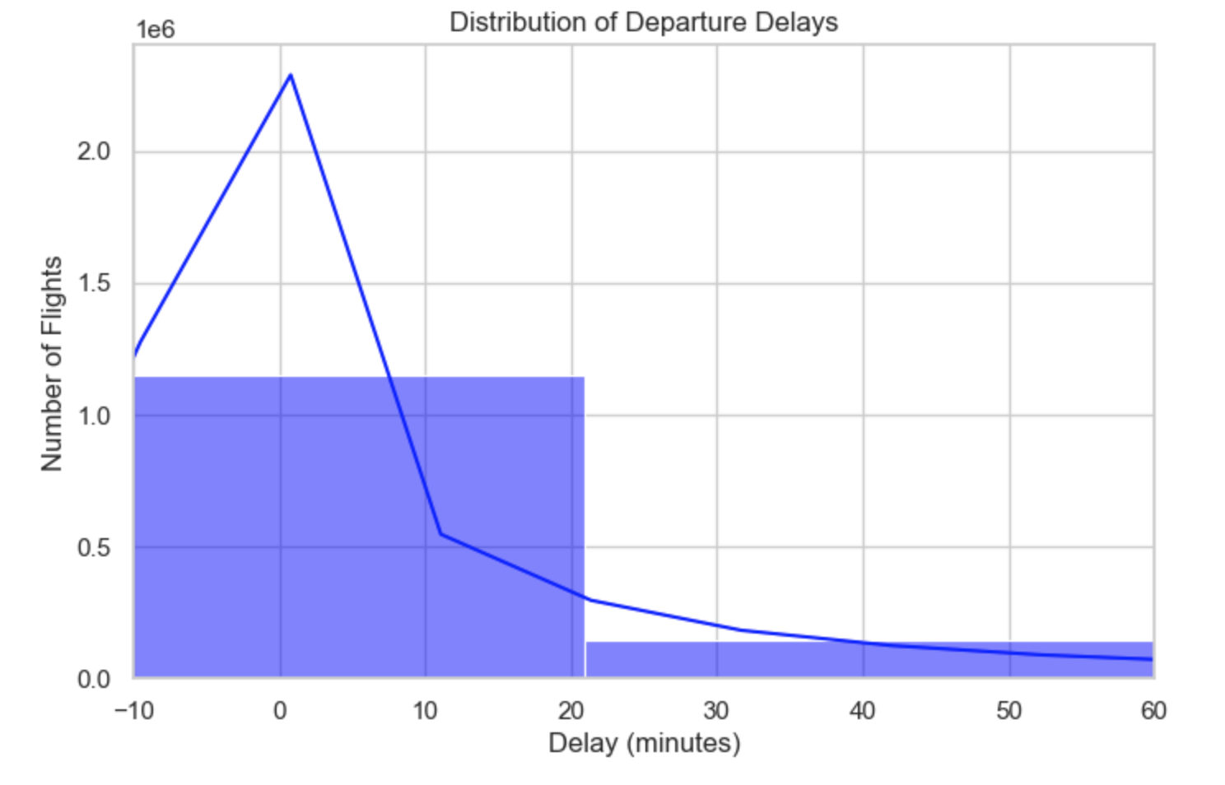
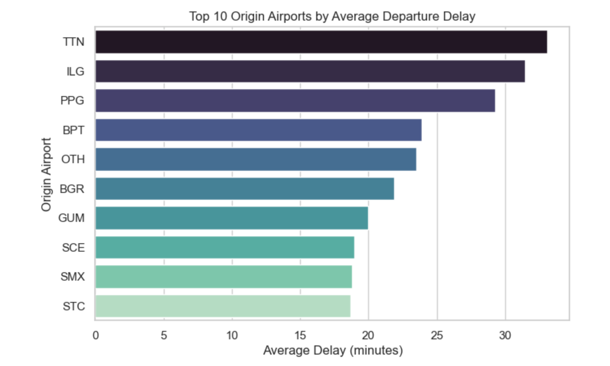
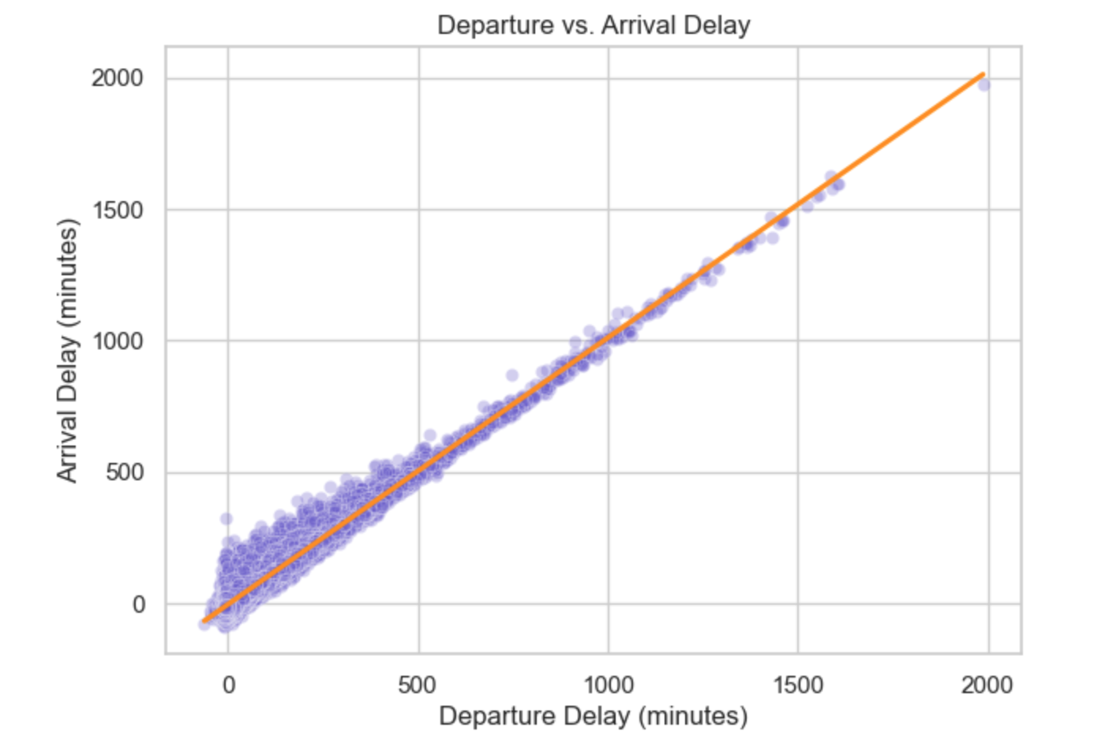
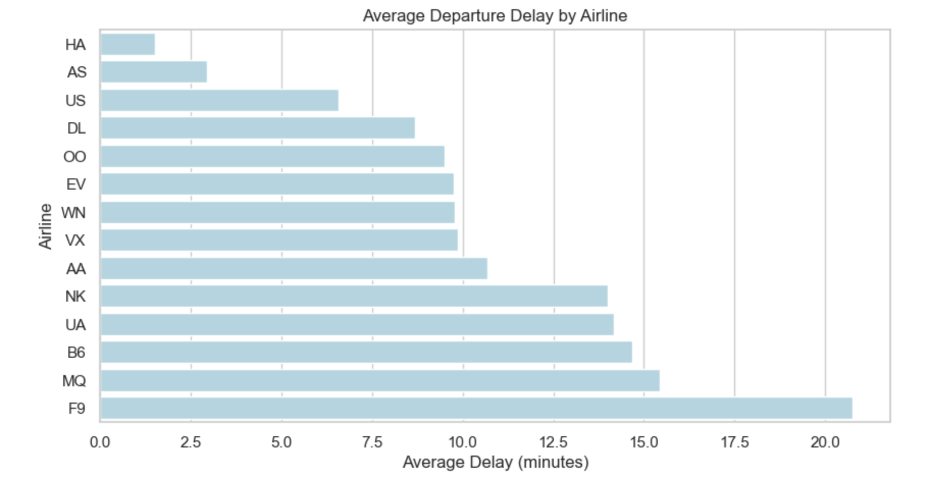
Analyze data

Slide 9
Report
Dataset Summary:
The full cleaned dataset contained 1.42 million rows × 19 columns.
A subset of 400,000 rows was randomly sampled from the original dataset to make the analysis more efficient.
Descriptive Statistics & Distributions:
Most flights depart on time or within 15 minutes, and the distribution of delays is right-skewed with a small number of large delays.

Slide 10
Report
Comparisons Across Airlines:
Average delay times vary by airline, with some carriers showing consistently lower delay averages while others experience higher delays.
Airport Performance:
Major hub airports (ORD, JFK, LGA) show higher average departure delays, reflecting congestion and operational complexity.
Seasonal Patterns:
Clear seasonal peaks appear in June–July and December, driven by weather disruptions and increased travel volume.
Correlation Analysis:
While delays are positively associated overall (r ≈ 0.8), the relationship becomes nonlinear for severe delays: once departure delays exceed 60 minutes, arrival delays rise disproportionately faster.
The analysis clearly communicates where and when delays occur, providing insights that could guide operational planning and performance improvement.

Slide 11
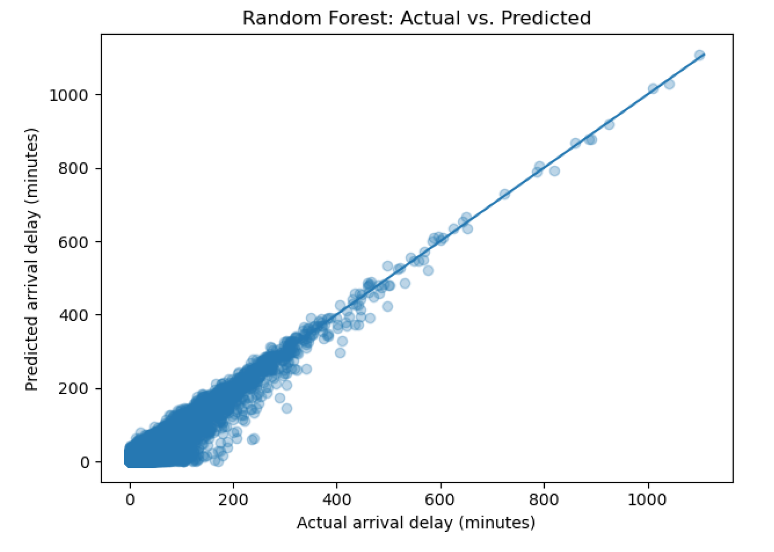
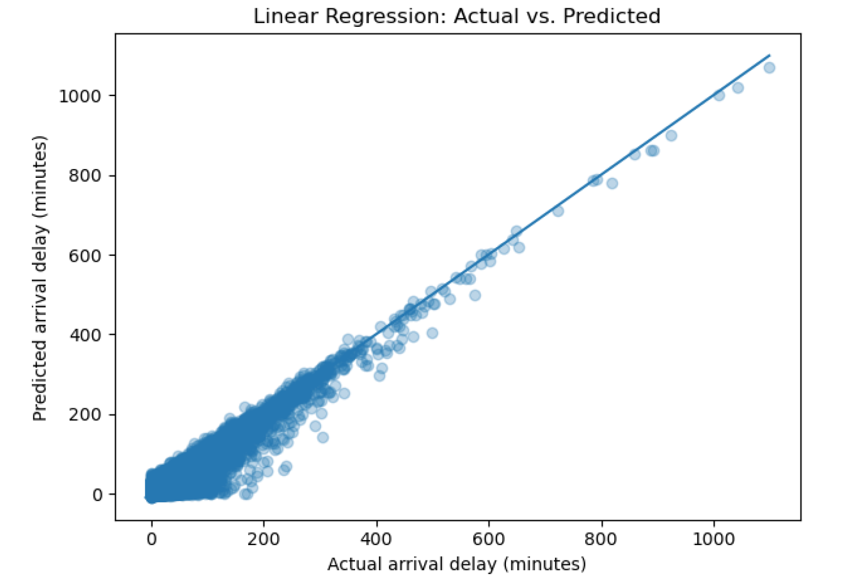
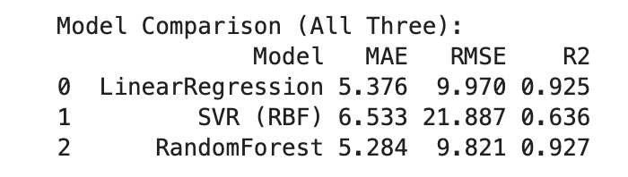
Act
Apply Results
- Random Forest (R² = 0.927) and Linear Regression (R² = 0.925) accurately predict arrival delays.
- Both models identify flights at high risk of arriving late, supporting proactive operations.
Recommendation
- Use Random Forest for operational delay prediction.
It performs best, captures nonlinear patterns, and handles outliers well.
- Avoid SVR (R² = 0.636) due to weak performance on large delays.
Operational Actions
- Add buffer time for flights predicted to be delayed.
- Improve turnaround and departure processes.
- Prioritize high-risk routes for staffing, gates, and resources.
- Use real-time alerts for flights likely to exceed 30-minute delays.
Connection
- These models provide actionable insights to reduce delays and improve on-time performance.

Slide 12
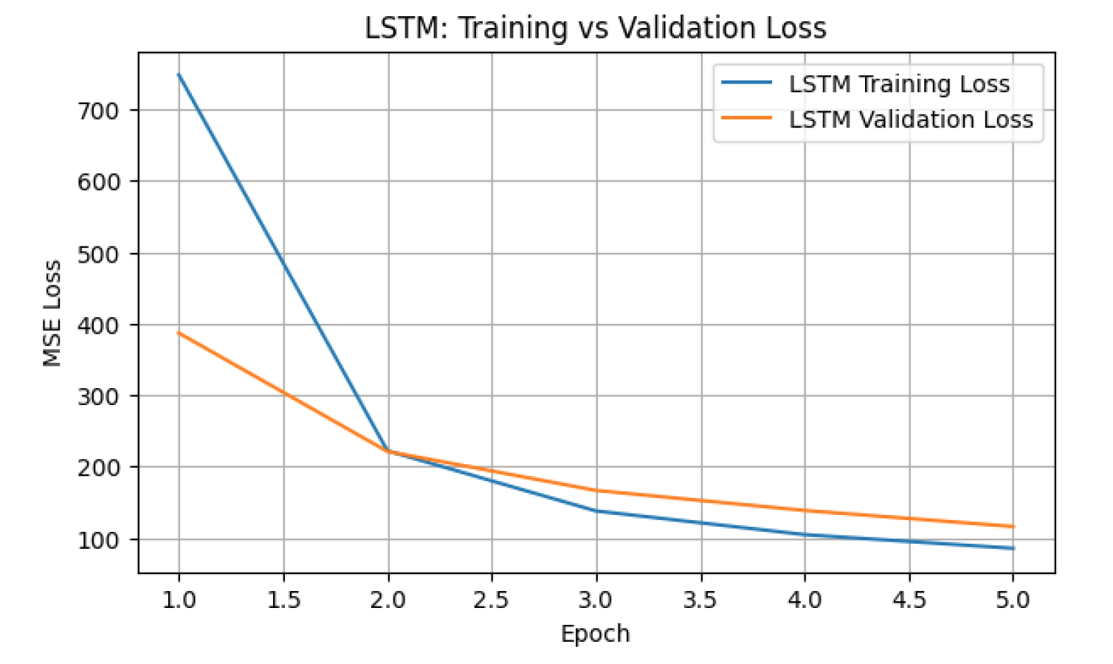
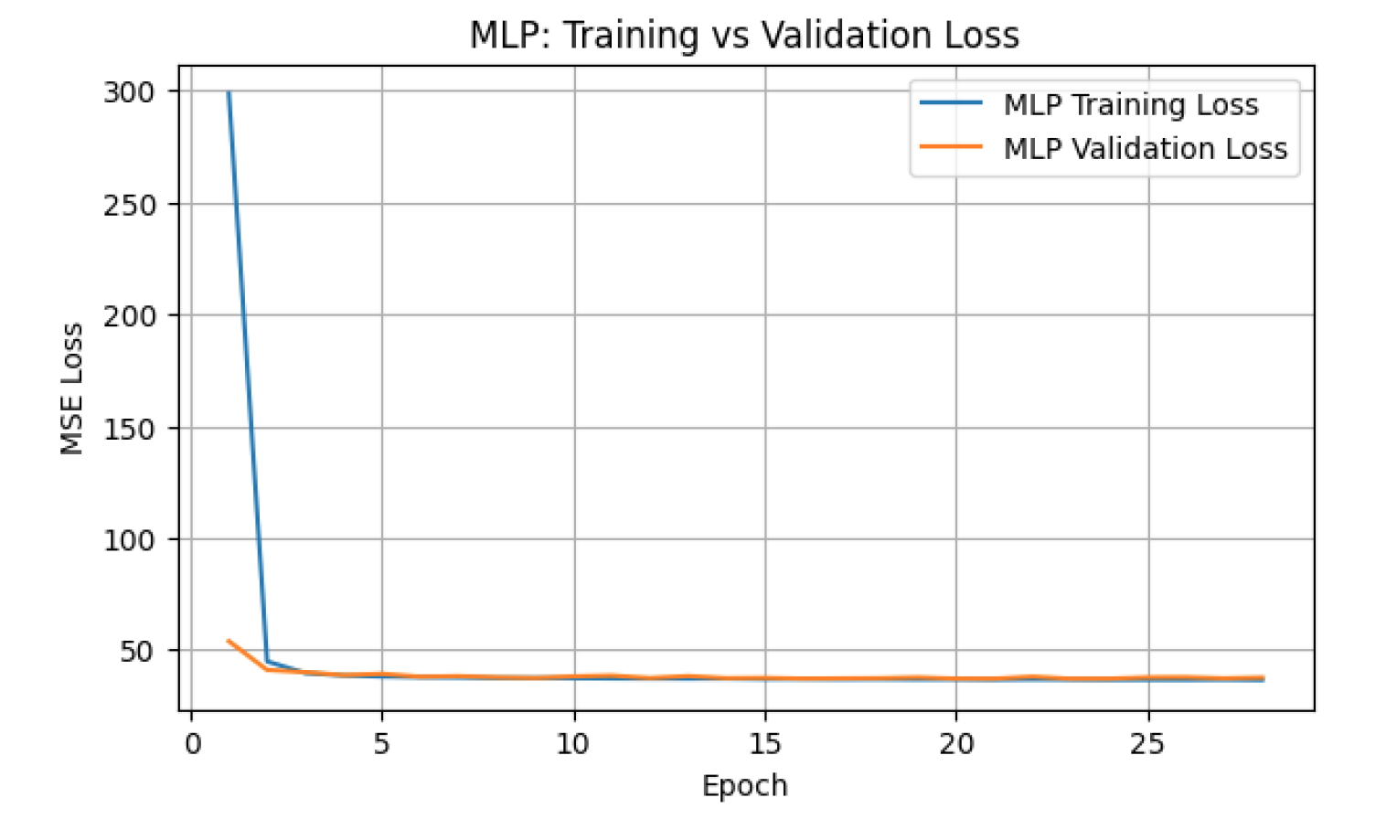
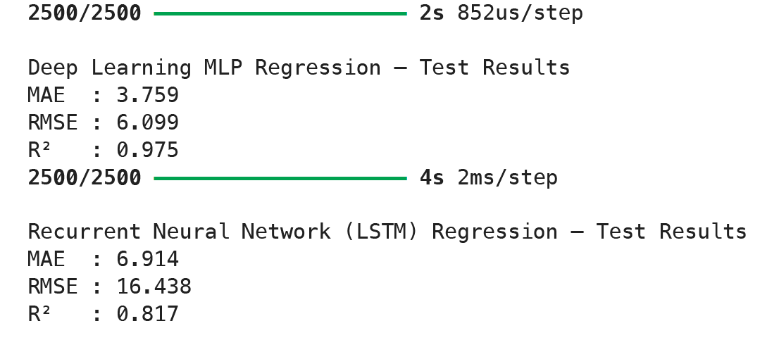
Act
Best Model
- Use MLP (R² = 0.975, RMSE = 6.1).
- LSTM underperforms because data is not sequential.
How to Apply
- Use MLP predictions to flag high-risk arrival delays.
- Feed predictions into operations dashboards.
Operational Actions
- Improve departure processes (departure delay - arrival delay).
- Add buffer time for predicted-late flights.
- Prioritize gates, crews, and resources for high-risk routes.
Impact
- More accurate delay predictions, better on-time performance and smoother operations.

